Slide 1
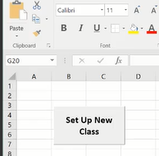
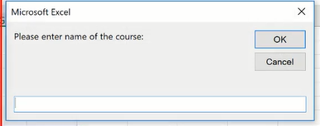
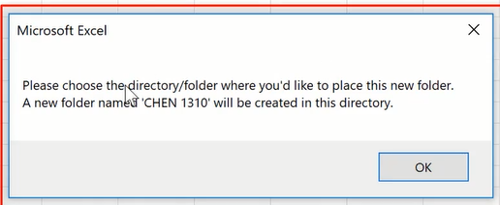
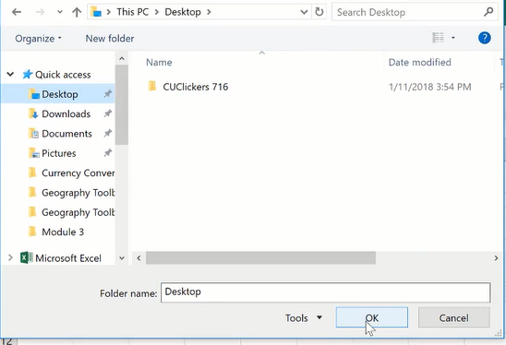
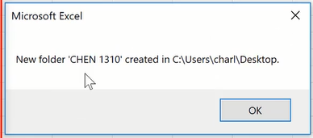
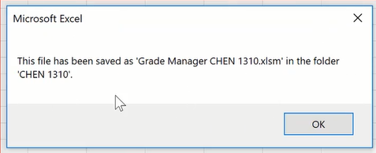
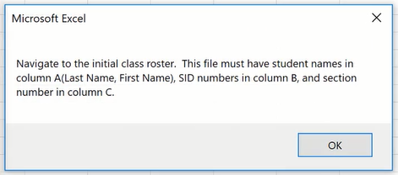
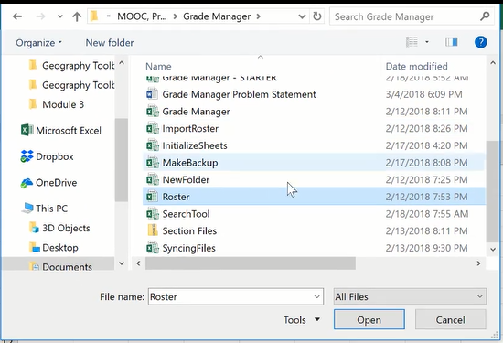
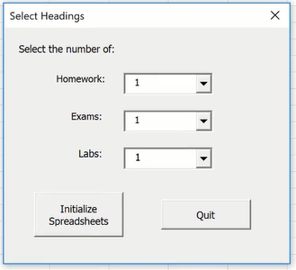
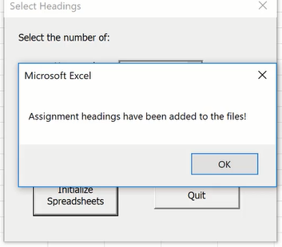
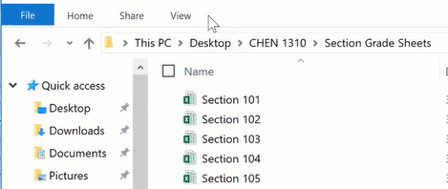

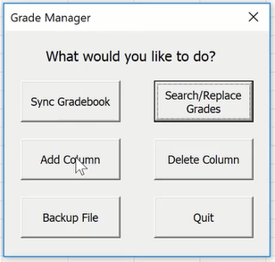
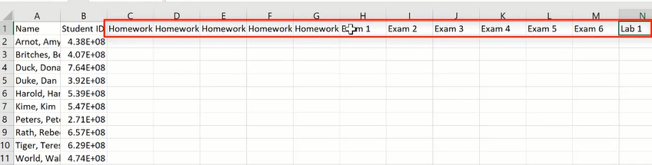
Grade Manager Project Instructions
The programme will separate the roster into different sub files or individual files corresponding to those section numbers (e.g. section numbers 101-105 produces 5 sub files).
The headings will also be added to all sub files

Slide 2
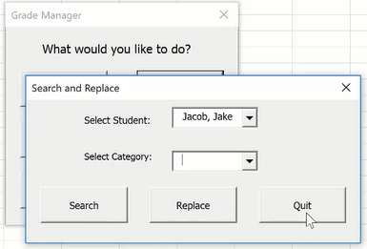
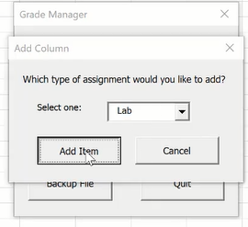
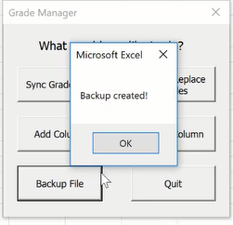
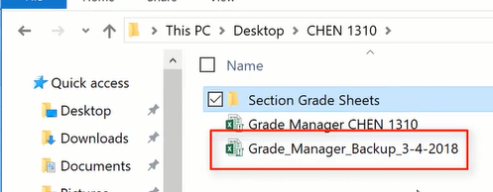
Maybe you have different co-workers doing different things, and you might each be working with separate files, and you might actually have them on something like Drop box. I have a drop box down here that I can share these with my TA (or colleagues). And periodically, I'm going to get these updated files and I'm going to want to sync so I can sync the grade book.
The Search button allows the user to search for a student’s grade in the Roster file
The Add Column button opens all sub files and add a selected heading to a new column in each of the sub files.
We have a backup file with today's date on there.

Slide 3
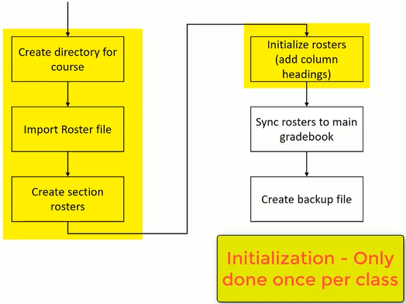
Now, the first four boxes here of this flowchart are the initialization process. This will only happen once for each class. The initialization is taken care of in the following Subs():
NewFolder()
ImportRoster()
CreateRosters()
InitializeSubFiles()
Once everything is initialized and set up, then the only things to be done are to allow user to add columns, sync the roster, search grades and create backup files.

